Slide 1
SMART BEVERAGE VENDING MACHINE
By KAMATE KATENDE TIMOTHEE
202312051

Slide 2
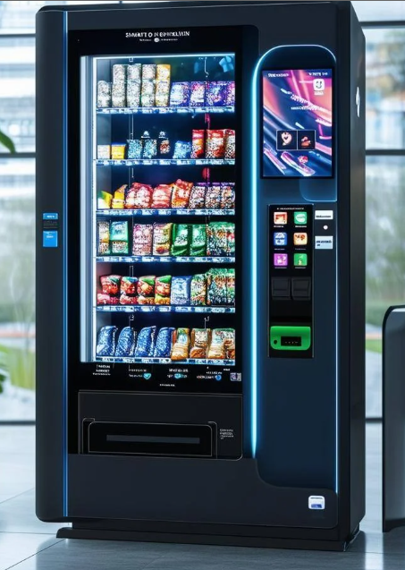
INTRODUCTION
A vending machine is an automatic machine that dells different types of food when inserting a payment.

Slide 3
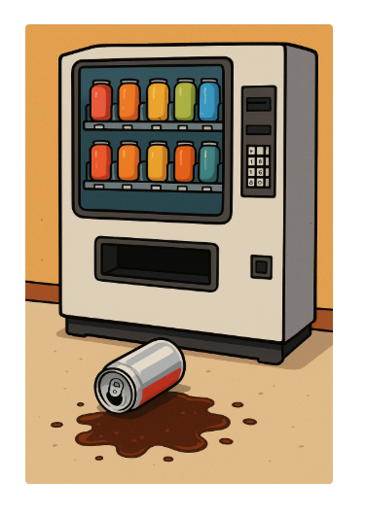
Current Common Design

Slide 4
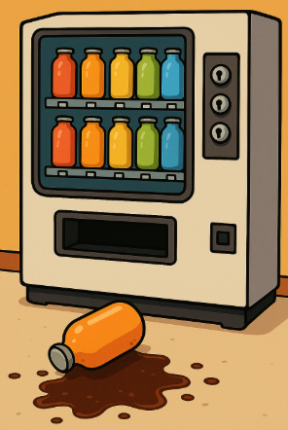
Current progress in Rwanda
Digital method implemented but supplier door still can be easily tampered and no notification to admin
Second bullet point here
Third bullet point here

Slide 5
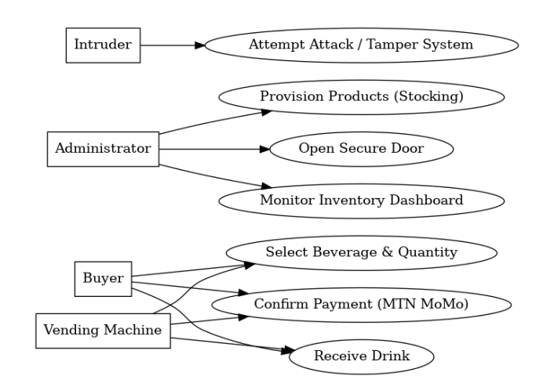
Proposed System

Slide 6
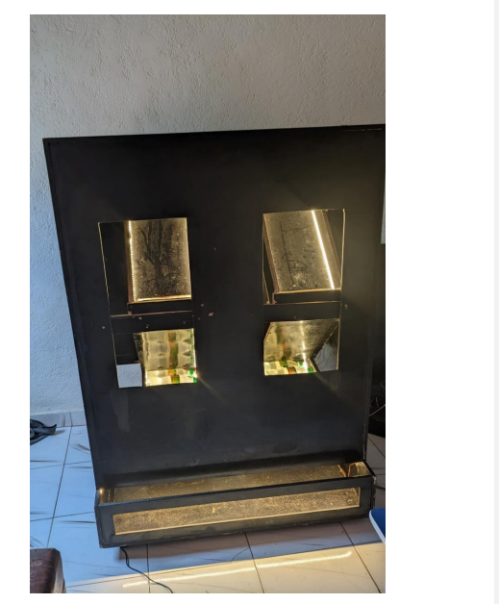
Proposed System
Reduce cost
Use gravity
Reduce chocs

Slide 7
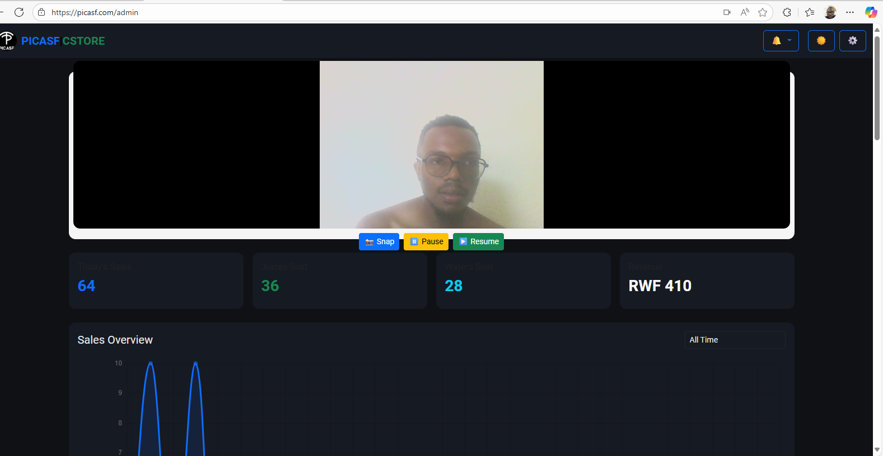
MONITORING

Slide 8
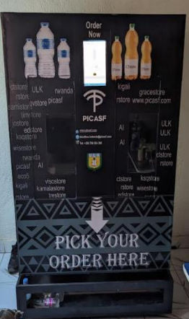
Current

Slide 9
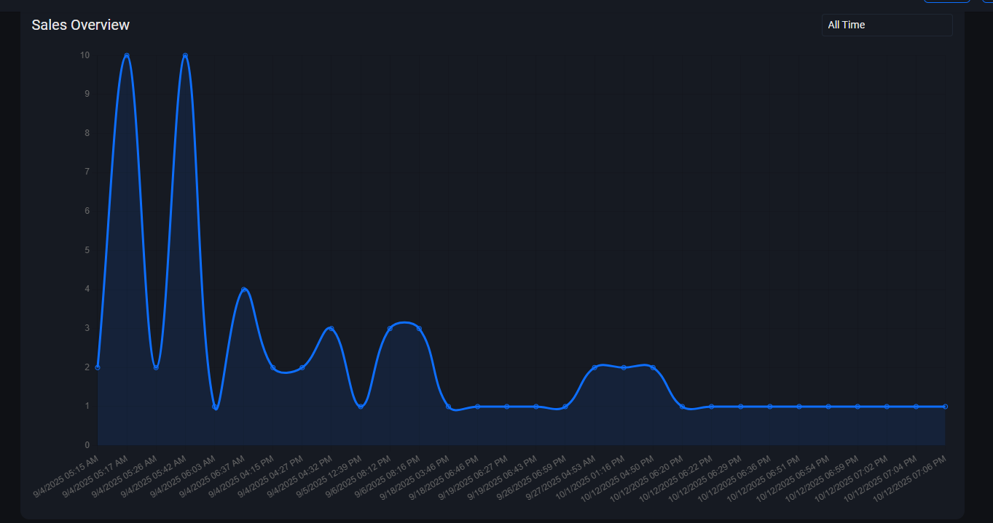

Slide 10
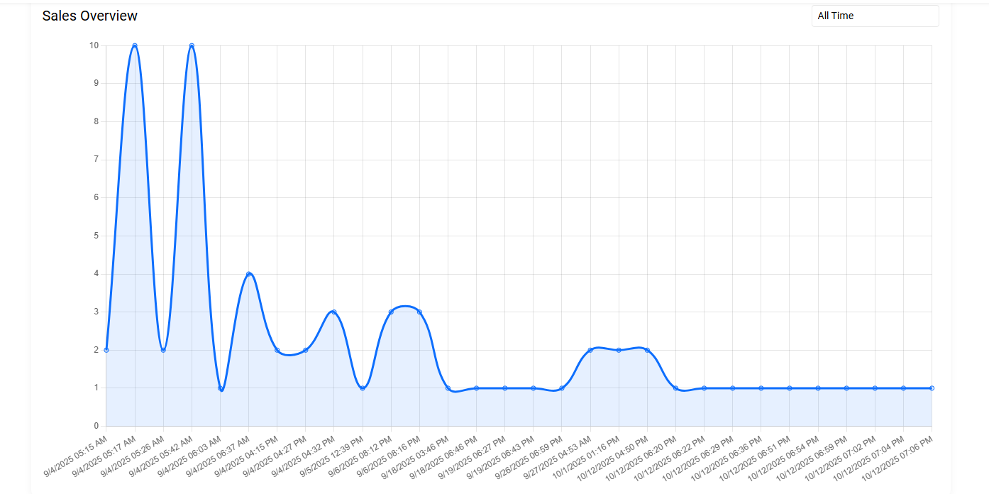

Slide 11
THANK YOU FOR LISTENING

